Slide 1
Other Models of Computation

Slide 2
Models of computation:
Turing Machines
Recursive Functions
Post Systems
Rewriting Systems

Slide 3
Church’s Thesis:
All models of computation are equivalent
Turing’s Thesis:
A computation is mechanical if and only if
it can be performed by a Turing Machine

Slide 4
Church’s and Turing’s Thesis are similar:
Church-Turing Thesis

Slide 5
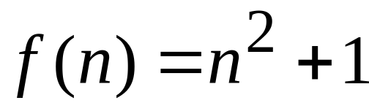


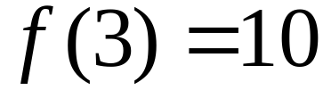
Recursive Functions
An example function:
Domain
Range

Slide 6
We need a way to define functions
We need a set of basic functions

Slide 7
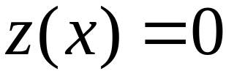
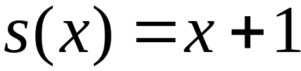
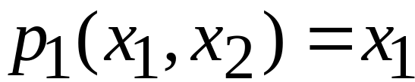
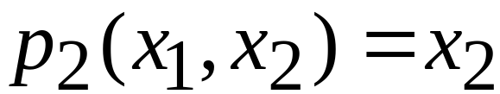
Basic Primitive Recursive Functions
Zero function:
Successor function:
Projection functions:

Slide 8
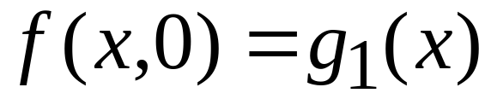
Building complicated functions:
Composition:
Primitive Recursion:

Slide 9
Any function built from
the basic primitive recursive functions
is called:
Primitive Recursive Function

Slide 10
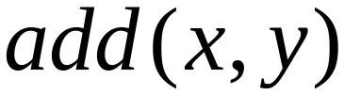
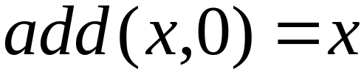
A Primitive Recursive Function:
(projection)
(successor function)

Slide 11
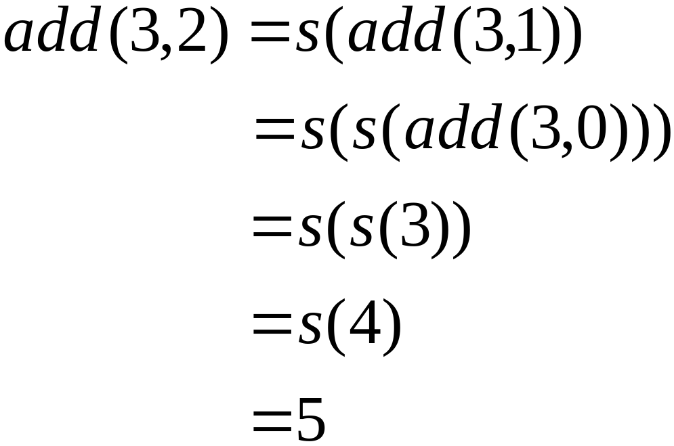

Slide 12
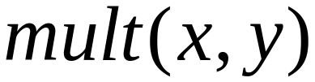
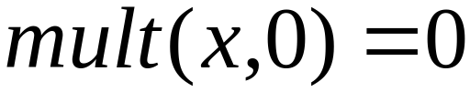
Another Primitive Recursive Function:

Slide 13
Theorem:
The set of primitive recursive functions
is countable
Proof:
Each primitive recursive function
can be encoded as a string
Enumerate all strings in proper order
Check if a string is a function

Slide 14
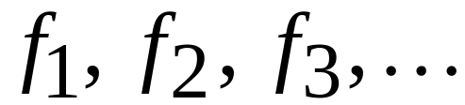
Theorem
there is a function that
is not primitive recursive
Proof:
Enumerate the primitive recursive functions

Slide 15
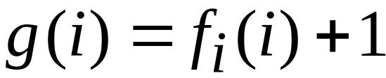


Define function
differs from every
is not primitive recursive
END OF PROOF

Slide 16
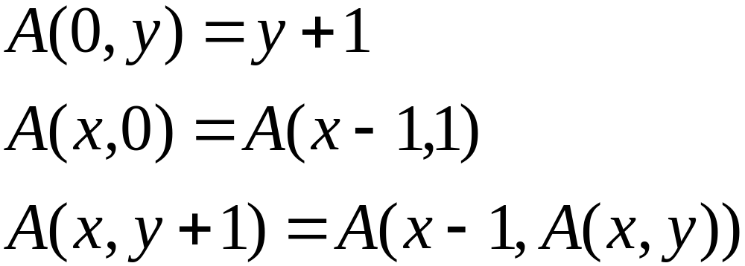
A specific function that is not
Primitive Recursive:
Ackermann’s function:
Grows very fast,
faster than any primitive recursive function

Slide 17

Recursive Functions
Accerman’s function is a
Recursive Function

Slide 18
Recursive Functions
Primitive recursive functions

Slide 19
Post Systems
Have Axioms
Have Productions
Very similar with unrestricted grammars

Slide 20

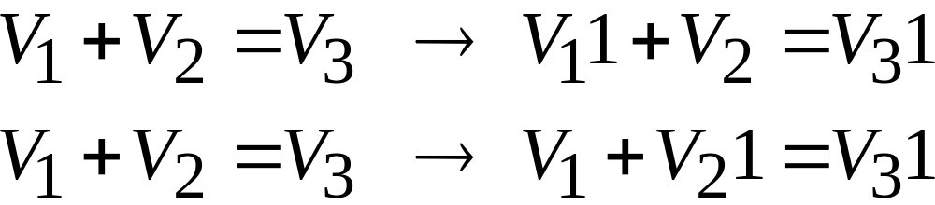
Example: Unary Addition
Axiom:
Productions:

Slide 21
A production:

Slide 22
Post systems are good for
proving mathematical statements
from a set of Axioms

Slide 23
Theorem:
A language is recursively enumerable
if and only if
a Post system generates it

Slide 24
Rewriting Systems
They convert one string to another
Matrix Grammars
Markov Algorithms
Lindenmayer-Systems
Very similar to unrestricted grammars

Slide 25
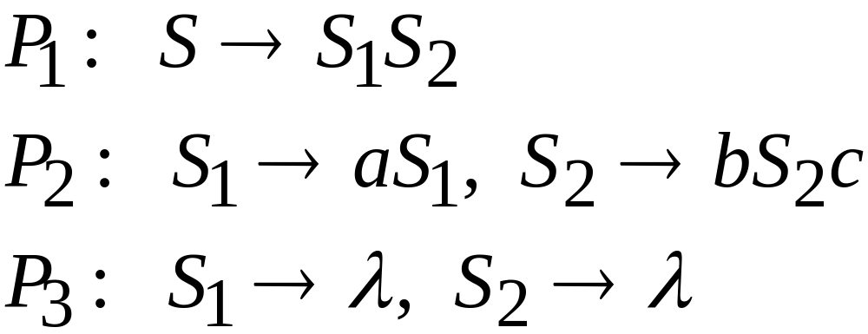
Matrix Grammars
Example:
Derivation:
A set of productions is applied simultaneously

Slide 26
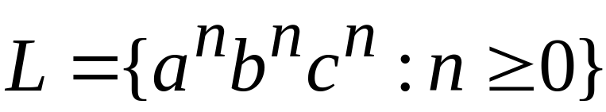
Theorem:
A language is recursively enumerable
if and only if
a Matrix grammar generates it

Slide 27

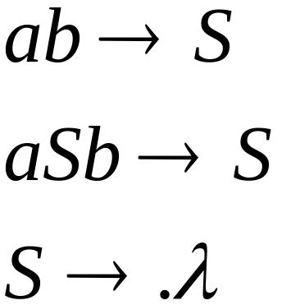
Markov Algorithms
Grammars that produce
Example:
Derivation:

Slide 28
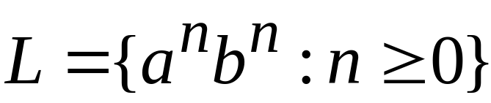

Slide 29
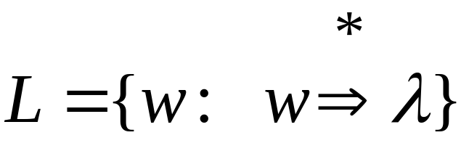
In general:
Theorem:
A language is recursively enumerable
if and only if
a Markov algorithm generates it

Slide 30

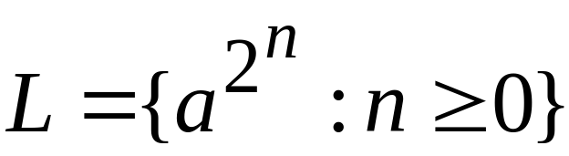
Lindenmayer-Systems
They are parallel rewriting systems
Example:
Derivation:

Slide 31
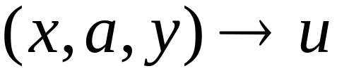
Lindenmayer-Systems are not general
As recursively enumerable languages
Extended Lindenmayer-Systems:
context
Theorem:
A language is recursively enumerable
if and only if an
Extended Lindenmayer-System generates it

Slide 32
Computational Complexity

Slide 33
Time Complexity:
The number of steps
during a computation
Space Complexity:
Space used
during a computation

Slide 34
Time Complexity
We use a multitape Turing machine
We count the number of steps until
a string is accepted
We use the O(k) notation

Slide 35
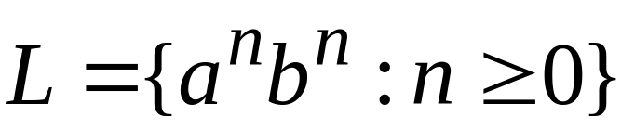



Example:
Algorithm to accept a string :
Use a two-tape Turing machine
Copy the on the second tape
Compare the and

Slide 36
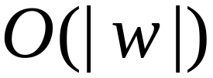
Time needed:
Copy the on the second tape
Compare the and
Total time:

Slide 37

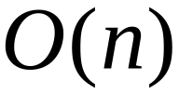
For string of length
time needed for acceptance:

Slide 38
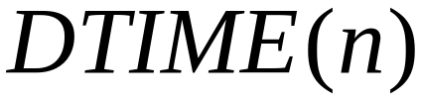



Language class:
A Deterministic Turing Machine
accepts each string of length
in time

Slide 39
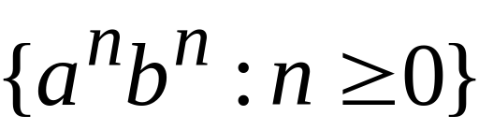
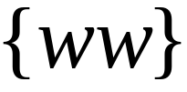

Slide 40
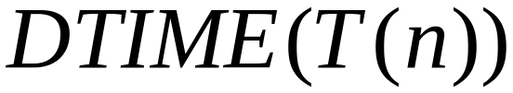
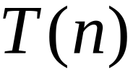
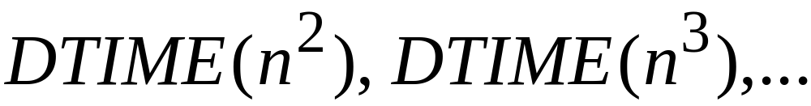
In a similar way we define the class
for any time function:
Examples:

Slide 41
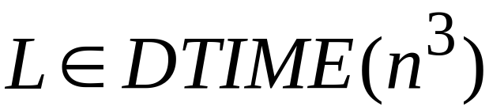
Example: The membership problem
for context free languages
(CYK - algorithm)
Polynomial time

Slide 42
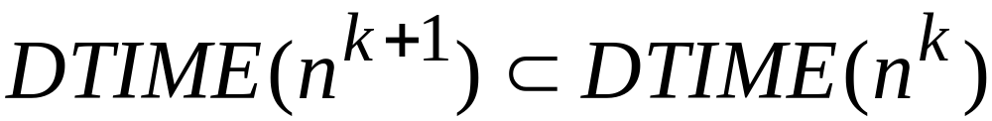
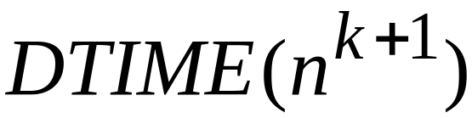
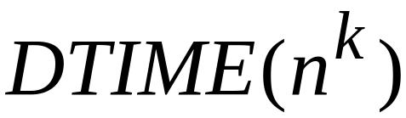
Theorem:

Slide 43

Polynomial time algorithms:
Represent tractable algorithms:
For small we can compute the
result fast

Slide 44

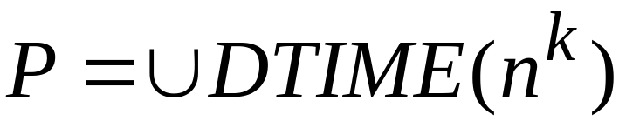
The class
for all
Polynomial time
All tractable problems

Slide 45
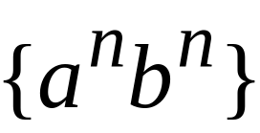
CYK-algorithm

Slide 46
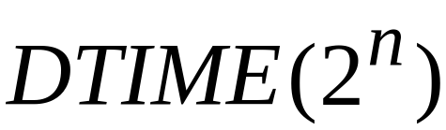
Exponential time algorithms:
Represent intractable algorithms:
Some problem instances
may take centuries to solve

Slide 47
Example: the Traveling Salesperson Problem
5
3
1
2
4
2
6
10
8
3
Question: what is the shortest route that
connects all cities?

Slide 48
5
3
1
2
4
2
6
10
8
3
Question: what is the shortest route that
connects all cities?

Slide 49
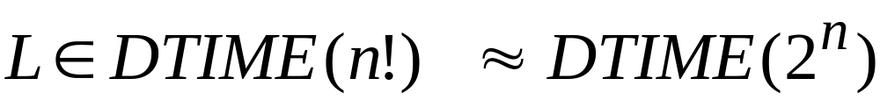
A solution: search exhuastively all
hamiltonian paths
L = {shortest hamiltonian paths}
Exponential time
Intractable problem

Slide 50
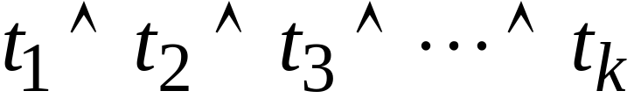
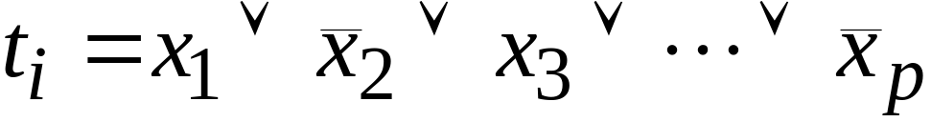
Example: The Satisfiability Problem
Boolean expressions in
Conjunctive Normal Form:
Variables
Question: is expression satisfiable?

Slide 51
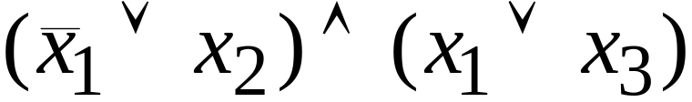
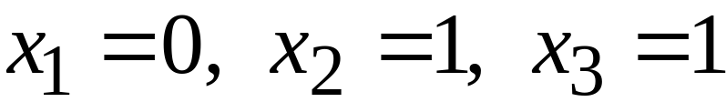
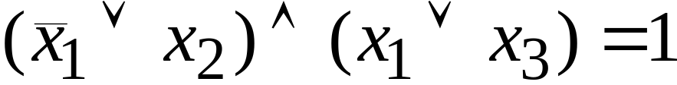
Example:
Satisfiable:

Slide 52
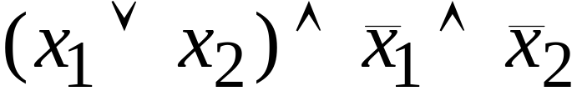
Example:
Not satisfiable

Slide 53
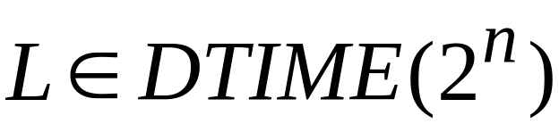
For variables:
exponential
Algorithm:
search exhaustively all the possible
binary values of the variables

Slide 54
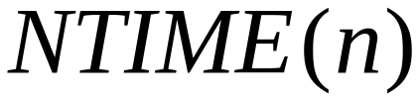
Non-Determinism
Language class:
A Non-Deterministic Turing Machine
accepts each string of length
in time

Slide 55
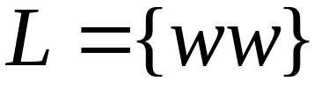

Example:
Non-Deterministic Algorithm
to accept a string :
Use a two-tape Turing machine
Guess the middle of the string
and copy on the second tape
Compare the two tapes

Slide 56
Time needed:
Use a two-tape Turing machine
Guess the middle of the string
and copy on the second tape
Compare the two tapes
Total time:

Slide 58
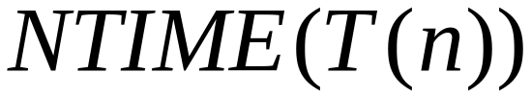

In a similar way we define the class
for any time function:
Examples:

Slide 59

Non-Deterministic Polynomial time algorithms:

Slide 60


The class
for all
Non-Deterministic Polynomial time

Slide 61
Example:
The satisfiability problem
Non-Deterministic algorithm:
Guess an assignment of the variables
Check if this is a satisfying assignment

Slide 62
Time for variables:
Guess an assignment of the variables
Check if this is a satisfying assignment
Total time:

Slide 63


The satisfiability problem is an - Problem

Slide 64

Observation:
Deterministic
Polynomial
Non-Deterministic
Polynomial

Slide 65

Open Problem:
WE DO NOT KNOW THE ANSWER

Slide 66
Open Problem:
Example: Does the Satisfiability problem
have a polynomial time
deterministic algorithm?
WE DO NOT KNOW THE ANSWER

Slide 67
NP-Completeness
A problem is NP-complete if:
It is in NP
Every NP problem is reduced to it
(in polynomial time)

Slide 68

Observation:
If we can solve any NP-complete problem
in Deterministic Polynomial Time (P time)
then we know:

Slide 69

Observation:
If we prove that
we cannot solve an NP-complete problem
in Deterministic Polynomial Time (P time)
then we know:

Slide 70
Cook’s Theorem:
The satisfiability problem is NP-complete
Proof:
Convert a Non-Deterministic Turing Machine
to a Boolean expression
in conjunctive normal form

Slide 71
Other NP-Complete Problems:
The Traveling Salesperson Problem
Vertex cover
Hamiltonian Path
All the above are reduced
to the satisfiability problem

Slide 72
Observations:
It is unlikely that NP-complete
problems are in P
The NP-complete problems have
exponential time algorithms
Approximations of these problems
are in P

